Slide 1
Vaccines | Abbreviation
Haemophilus Influenzae Type B | Hib
Hepatitis A | HepA
Hepatitis B | HepB
Herpes Zoster | Herpes Zoster
Human papillomavirus | HPV
Inactivated Poliovirus | IPV
Live Attenuated Influenza Vaccine | LAIV
Measles, Mumps and Rubella | MMR
Pneumococcal Conjugate Vaccine | PCV
Pneumococcal polysaccharide Vaccine | PPSV
Quadrivalent Meningococcal Conjugate Vaccine | MCV
Quadrivalent Meningococcal Polysaccharide Vaccine | MPSV
Rotavirus | Rotavirus
Tetanus and Diptheria toxoids | Td
Diphtheria, Tetanus Toxoids and Pertussis | DTaP
Tetanus toxoid, Diptheria toxoid and acellular pertussis | Tdap
Varicella | Varicella
Notes:
Papilloma refers to a benign epithelial tumor

Slide 2
Vaccines | Use (table 1 of 2)
Hib | Haemophilus influenzae is a GNR that can cause bacterial meningitis.
LAIV | Influenza virus. Nasal only
HepA | Virus contracted by eating uncooked/fecal food of people with Hep A. Children and travelers should get the vaccine
HepB | Transmitted through contact with the blood and body fluids of someone who is infected — the same way as HIV.
Herpes Zoster | Shingles
HPV | STD that may cause warts. Symptoms will go away but the person can still transmit.
IPV | Polio virus is a disease that can affect nerves and can lead to partial or full paralysis
MMR | Measles: Causes Rash. most deaths include pneumonia and inflammation of the brain (encephalitis). Mumps: Swelling of the Salivary Glands Rubella: German measles, is an infection in which there is a rash on the skin
PCV | Infection with Streptococcus pneumoniae bacteria can make children very sick. It causes blood infections, pneumonia, and meningitis, mostly in young children.
PPSV | Pneumococcal disease is caused by Streptococcus pneumoniae bacteria
MCV | Vaccine against Neisseria meningitidis (Meningococcus). Meningococcal conjugate vaccine (MCV4) is the preferred vaccine for people 55 years of age and younger.
MPSV | Vaccine against Neisseria meningitidis (Meningococcus). meningo-coccal vaccine licensed for people older than 55.

Slide 3
Vaccines | Use (table 2 of 2)
Rotavirus | Rotavirus is a virus that causes diarrhea (sometimes severe), mostly in babies and young children
Td | Tetanus: caused by Clostridium tetani. Diptheria: Caused by Corynebacterium diphtheriae (gram +) is an upper respiratory tract infection.
DTaP for children | Diptheria: Caused by Corynebacterium diphtheriae (gram +) is an upper respiratory tract infection. Tetanus: caused by Clostridium tetani. Pertussis: respiratory infection caused by Bordetella pertussis that causes babies to have difficulty breathing. DTaP is approved for children under 7.
Tdap For adults | Same as DTaP Tdap, which has a reduced dose of the diphtheria and pertussis vaccines, is approved for adolescents starting at the age of 11 and adults ages 19 to 64. Immunity wears off over time. So the current recommendation is that everyone needs a booster shot for tetanus and diphtheria every 10 years
Varicella | Chickenpox
Vaccine | Age | Use in
DTaP | < 7 y/o
DT | < 7 y/o | CI to DTaP
Tdap | One time over 10 y/o Then use > 65 y/o | Use as a 1 time shot in adults Use again when > 65 y/o
TD | Adults every 10 years until 65 y/o | Used as a booster
Notes:
Diphtheria, Tetanus Toxoids and Pertussis

Slide 4
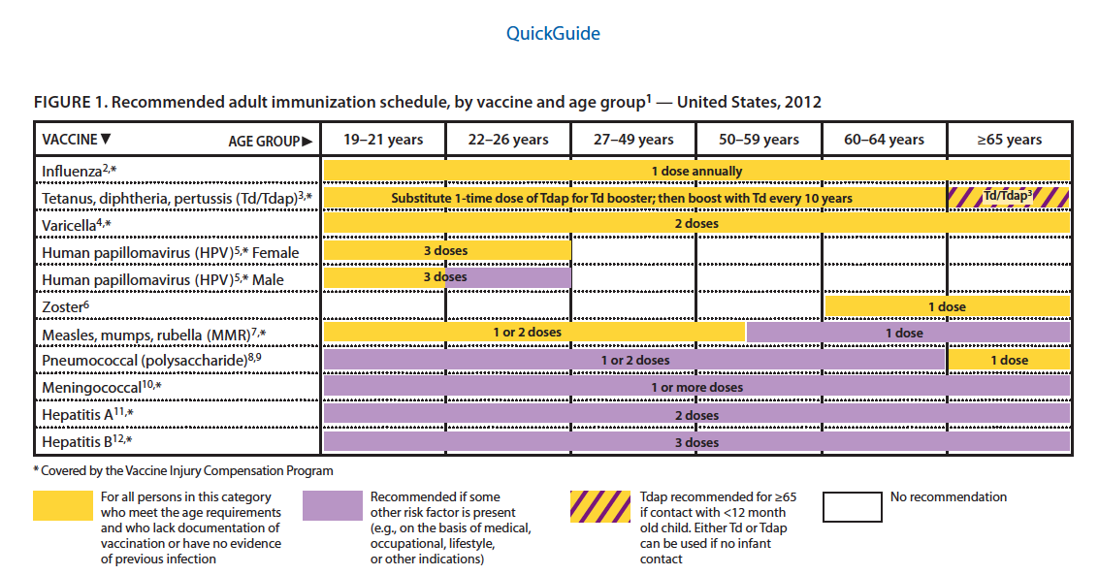
Adults Over 19 y/o
PCV23
q 5 years
HPV Vaccine: Minimum 9 y/o
2nd shot 2 months later
3rd shot 6 months later

Slide 5
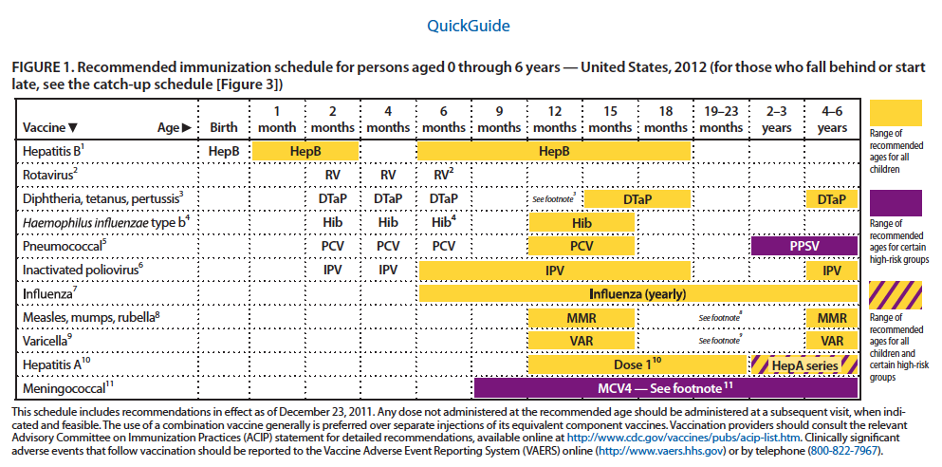
Children age 0 – 6 y/o
Hib

Slide 6
Live Vs Killed Vaccines
if | Minimum interval
Given before minimum age | Shot can be given no more than 4 days before the min age
2 inactivated | Can be give at any time
Inactivated + Live | Can be given at any time
2 Live | Can be given simultaneously at different sites or if person decides to wait then 4 weeks apart
Antibody products + Live Ex: blood, Immuno globin, platelets | If Live Vaccine first wait 2 Weeks for Blood If Blood first, wait 3 Months for live vaccine If Blood first, wait 8 months for MMR
Live Vaccines
Influenza (live intranasal)
Measles, Mumps Rubella
Varicella
Zoster
Rotavirus
Polio (oral vaccine)
Inactivated Vaccines
Influenza Injectable (IPV)
Hep A and B
Meningitis
Pneumococcal polysaccharide
Polio (injectable)
Inactivated Toxoid
Pertussis
Diptheria
Green Contraindicated in Allergy
Hep, Men Pneu
Purple contraindicated in Pregnancy:
The ZMMV
Notes:
Contraindications:
PMH = Allergy
R, MMR, L, Z = Pregnancy, immunodeficiency

Slide 7
Hepatitis A
Who: people at risk for hep a
S/E and Precautions
1. Pregnant

Slide 8
Hepatitis B
(B for Birth. Give at birth)
When
1st dose Birth (within 12 hrs)
2nd dose 1 -2 months
3rd dose 6 – 18 months
S/E and Precautions
1. Infant weights < 2 kg (4.4 lb)
If mother has HepB (has Hep B surface antigen) and gives birth, the child must be given:
HepB vaccine
+
HepB Immune Globulin (HBIG) 0.5 mL
within 12 hours of birth
Test child for hepB
1 month after vaccine
and at
1 y/o

Slide 9
Haemophilus Influenzae type B (Hib)
Vaccine is Conjugated
When
2, 4, 6 months
12 – 15 y/o
Contraindications:
Age < 6 weeks
Hi6

Slide 10
HPV Vaccine (genital warts)
3 shots
- Age 11-12 y/o (up to 26 y/o)
- 1-2 months after
- 6 months after
HPV has types 6, 11, 16, 18
type 6 and 11 are for genital warts
types 16 and 18 are for cancer
HPV4 (Gardasil) has type 6, 11, 16 and 18
HPV2 (Cervarix) has types 16 and 18
Why: Warts can cause cervical, vaginal and vulvar cancer. Vaccine can prevent these cancers
S/E and Precautions
Syncope
Pregnancy
Misperceived contraindications (it’s ok)
Hx Genital warts
Known HPV infection
Immunosuppression
Breastfeeding

Slide 11
Influenza Vaccine
Types:
TIV (trivalent Influenza Vaccine)
pts with immunocompetence
LAIV (Live attenuated influenza vaccine)
pts with normal immune system
Contraindication to Inactive Vaccine
Anaphylactic Allergy to eggs b/c the influenza vaccine is prepared using embryonated chicken eggs.
Contraindication to Live Vaccine
Eggs
< 2 y/o or > 50 y/o
Hx of Guillain Barré syndrome
Pregnant
Immunosuppressed
Misperceived contraindications (it’s ok)
1. Being in contact with immunocompetence patients

Slide 12
Meningococcal (MCV4 and MPSV4)
Types
MCV4 (conjugate vaccine): pts aged 2 – 55 y/o
MPSV4 (polysaccharide): pts age > 56 y/o
When
dose 1 age 11-12 y/o
booster age > 16 y/o
travelers
Who: Meningococcal is given every 5 years to Asplenic patients and others at continued risk for exposure to this pathogen.
S/E and Precautions
Syncope
Misperceived contraindications (it’s ok)
1. Guillain–Barré syndrome (paralysis) is not associated with meningococcal vaccine. Just monitor for leg weakness
Notes:
Conjugate polysaccharide: are developed by attaching a polysaccharide antigen to a carrier protein, which helps the body recognize the antigen as a foreign substance that must be destroyed. This method enhances the body’s immune response to a vaccine
Conjugate vaccines are for children < 2 y/o

Slide 13
Measles, Mumps, Rubella (MMRV)
(Rubella aka German Measles)
Type: Live Attenuated (intranasal)
When: 1st dose at 12 months or older
2nd dose at 6 y/o (when go to school)
Wait 8 months before giving MMR if pt is given IVIG replacement therapy
Contraindication:
MMR vaccine should not be administered to severely immunocompromised persons.
Pregnant: passive transfer of maternal antibody or a fetal antibody response to vaccine virus infection in the fetus.
Plan to become pregnant within the next 4 weeks
S/E and Precautions
Received blood within 11 months
Hx thrombocytopenia (b/c of immune response). platelet count of < 50,000/microL
Misperceived contraindications (it’s ok)
Positive TB test
Breastfeeding
Close contact with pregnant
Not linked to autism
Notes:
Treponema Pallidum Great pox (syphilis)
Variola Virus Small Pox (deadly)
Varicella Virus Chicken Pox (chicken b/c it’s the lame version of small pox)
Rubella German Measles. Is dangerous to fetus

Slide 14
PCV-7 Pneumococcal Conjugate
And
PCV13 Pneumococcal conjugate
(Conjugate vaccines stimulate the T-cell DEPENDENT immunity. T-Cells involved)
There are 90 pneumococcal strains
PCV covers 7 of the strains
PCV13 covers 13 of the strains
Use for children < 2 y/o
Use PCV7 if:
Sickle cell disease
HIV, DM
Cardiac disease
Use PCV13 if
Normal child
Notes:
Smokers, immunocompromised
Conjugate vaccines are for children < 2 y/o

Slide 15
PPSV23 Pneumococcal Polysaccharide
(Polysaccharide vaccines stimulate the T-cell INDEPENDENT immunity. No T-cells involved))
Who
> 65 y/o
2 – 64 y/o every 5 years if
immunocompromised, renal failure
asthma, sickle cell, DM, cirrhosis
Notes:
Smokers, immunocompromised
Conjugate vaccines are for children < 2 y/o

Slide 16
Inactivated Polio Virus (IPV)
S/E and Precautions
1. Pregnancy

Slide 17
Rotavirus (oral)
Type: Live Attenuated Vaccine
Contraindication
SCID (Severe combined immunodeficiency). Both B and T cells are impaired
S/E and Precautions
immunocompetence other than SCID
Intussusception (intestine is folded onto itself)
Chronic Gastrointestinal disease
Spina bifida (spine doesn't close)
Misperceived contraindications (it’s ok)
Immunosuppressed family members

Slide 18
Shingles (Herpes Zoster Vaccine)
Type: Live Attenuated
When: 1 dose at 60 y/o
Why: to prevent neuralgia
Misperceived contraindications (it’s ok)
1. Therapy with low-dose methotrexate (≤0.4 mg/kg/week), azathioprine (≤3.0 mg/kg/day), or 6-mercaptopurine (≤1.5 mg/kg/day) for treatment of rheumatoid arthritis, psoriasis, polymyositis, sarcoidosis, inflammatory bowel disease, or other conditions
2. In contact with immunocompetence pts

Slide 19
Tdap or DTap
DTap dosing
Children: 2, 4, 6 months
15 – 18 months
4 – 6 years
Booster Tdap is given q10 years
Contraindication:
children who experienced ENCEPHALOPATHY within 7 days after administration of a previous dose of DTap . Don’t give pertusis vaccine.
S/E and Precautions
Syncope
Unstable Neurologic disorders including spasms and Epilepsy (seizures)
Temp > 105 F w/i 2 days after previous shot
Guillain-Barré syndrome within 6 weeks of Tdap
Misperceived contraindications (it’s ok)
Fever < 105 F
Family history of seizures
Stable neurologic disorders
Notes:
DTaP for children
Tdap for adults

Slide 20
Varicella Vaccine (aka Chicken Pox)
Type: Live Attenuated Vaccine
When:
1st dose 12 – 15 moths
2nd dose 4 – 6 years
Contraindications:
Pregnancy
Severe immunodeficiency
No ASA + Varicella in children within a few weeks of given vaccine
S/E and Precautions
Maculopapular rash for 5-26 days. Usually 2-5 lesions
Received blood within 11 months
Misperceived contraindications (it’s ok)
Close contact with pregnant
Immunodeficient family member
Get a few lesions within a month or so. It’s just a mild reaction. NBD
Notes:
Treponema Pallidum Great pox (syphilis)
Variola Virus Small Pox (deadly)
Varicella Virus Chicken Pox (chicken b/c it’s the lame version of small pox)
Rubella German Measles
Varicella immune globulin

Slide 21
Special Populations
Children with defects in phagocyte function should NOT receive live Bacterial vaccines
HIV patients if asymptomatic should receive MMR vaccine (live) and Varicella vaccine (live)
Immunocompromised patients should NOT receive LIVE bacterial nor viral vaccines
Patients with leukemia, lymphoma, or other malignancies whose disease is in remission, who have restored immunocompetence, and whose chemotherapy has been discontinued for at least 3 months can receive live-virus vaccines
Asplenia (surgical removal or congenital absence of the spleen): The spleen plays important roles in regard to red blood cells (also referred to as erythrocytes) and the immune system. Patients with Asplenia are at increased risk for infection by encapsulated bacteria, especially by S. pneumoniae (pneumococcus), N. meningitidis (Meningococcus), and Hib
Asplenia Vaccines | Age
MCV4 (meningococcal) | 2-55 to prevent hospital meningitis
MPSV4 (meningococcal) | > 55
Hib vaccine | 14 days before elective splenectomy. Else ASAP after pt is stable to prevent H influenza
PCV-7 (Pneumococcal) | < 2 y/o 14 days before elective splenectomy. Else ASAP after pt is stable to prevent nosocomial pneumonia
PCV23 (Pneumococcal) | > 2 y/o

Slide 22
